Slide 1

Introduction to Systems Engineering Practices: Session I - Requirements
John Azzolini
SEC jda: July, 2000

Slide 2
For Each System:
  Requirements Analysis
  Operations Analysis
  Design Analysis
  Risk Analysis
  Verification Analysis
  Validation

Slide 3
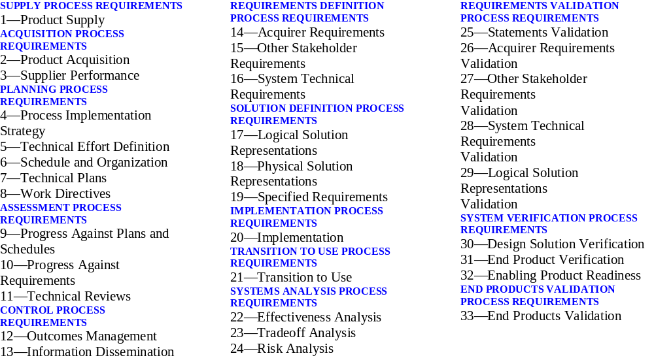
EIA 632, Process for the Engineering of a System: Summary

Slide 4
System Requirements Analysis
  Identification of Functional and Performance Requirements
  Allocation to Sub-elements
  Development of Hierarchy

Slide 5
System Operations Analysis
  Launch, Separation, and Deployment
  In-Orbit Checkout
  Science Observations
  Housekeeping
  First Partitioning of Functions Among Launch, Ground, and Flight Segments

Slide 6
System Design Analysis
  Conceptualize and Synthesize Design
  Analyze Design
  Trade Studies

Slide 7
System Risk Analysis
  Tight Margins
  Low maturity
  Tight Schedule
  Cost Risk

Slide 8
System Verification Analysis
  Identify Verification Methods
  Identify Verification Levels
  Identify Verification BTE and GSE
  Develop Verification Procedures
  Validate Methods, Levels, Procedures, and BTE and GSE

Slide 9
System Validation
  Assumptions
  Requirements to Objectives
  Operations Concept to Objectives
  Design to Requirements and Operations Concept
  Verification Plans to Requirements
  System Validation Testing

Slide 10

NPG 7120.5A Table of Contents

Slide 11
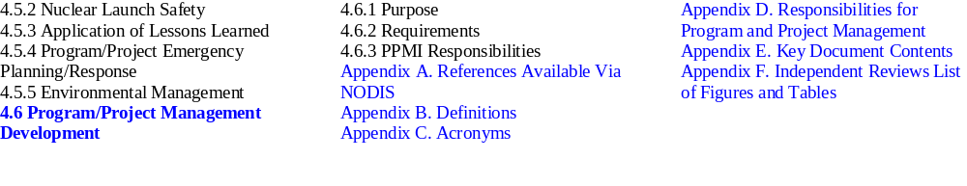
NPG 7120.5A Table of Contents (cont’d)

Slide 12
PART I:
REQUIREMENTS ANALYSIS

Slide 13
Requirements Analysis
Introduction and Definitions
The Requirements Analysis Process
Summary

Slide 14
Requirements Analysis
An engineer doesn't know what he's doing until a REQUIREMENT has been agreed to
You can't do a job without a PLAN
A professional makes a COMMITMENT to meet the Requirements Analysis within his planned resources
If you can't demonstrate TRACEABILITY from your plan to where you are, you're trying to fool the public
  A. Thomas Young

Slide 15
Requirements Analysis
“Research is what I'm doing when I don't know what I'm doing.”
Attributed to Wernher Von Braun

Slide 16
Requirements Analysis
A SYSTEMATIC ENGINEERING PROCESS
From EIA 632
Understand customer needs and establish objectives
Develop evaluation and rating criteria
Determine functions to be accomplished (functional analysis)
Develop concept architecture (with alternatives)
Define performance requirements for each function
Synthesize and iterate the designs (trade studies)
Evaluate the designs for acceptability (validate and verify)
Rate the acceptable designs and select the best alternative
Document the selected design
Requirements Definition
Solution Definition
Transition To Use
Systems Analysis
Requirements Validation
System Verification
End Products Validation

Slide 17
Requirements Analysis
MIL SE Handbook
Input Requirements
Mission Objectives
Mission Environments
Mission Constraints
Measures of Effectiveness
Functional
Analysis
Synthesis
Acceptable
Solution
Evaluation
and Decision
(Trade-off)
OR
OR
Will
Alternatives
Work?
Technology Selection Factors
Hardware
Software
Reliability
Maintainability
Personnel/Human Factors
Survivability
Security
Safety
Standardization
Integrated Logistics Support
EMC
System Mass Properties
Producibility
Transportability
Electronic Warfare
Computer Resources
Description of
System Elements

Slide 18
Requirements Analysis
NASA SE Handbook
The following questions
should be considered:
Have the goals / objectives and
constraints been met?
I the tentative selection
robust?
Is more analytical refinement
needed to distinguish among
alternatives?
Have the subjective aspects of
the problem been addressed?
Define / Identify
Goals / Objectives
and Constraints
Define
Plausible
Alternatives
Define
Selection
Rule
Perform Functional
Analysis
Define measures and
measurement methods for:
System effectiveness
System performance or
technical attributes
System cost
Collect data on
each alternative
to support
evaluation
by selected
measurement
methods
Compute an estimate of system effectiveness,
performance or technical attributes, and cost for
each alternative
Compute or estimate uncertainty ranges.
Perform sensitivity analyses
Is
tentative
selection
accept-
able?
Make a
tentative
selection
(decision)
Proceed to further
resolution of
system design,
or to
implementation
Analytical Portion of Trade Studies

Slide 19
Requirements Analysis
Recognize
Need or
Opportunity
Principle of Successive
Refinement
(Boehm’s Spiral
Development Model)
Identify and
Quantify Goals
Identify and
Quantify Goals
Identify and
Quantify Goals
Increase
Resolution
Increase
Resolution
Increase
Resolution
Create
Concepts
Create
Concepts
Create
Concepts
Do Trade
Studies
Select
Design
Do Trade
Studies
Select
Design
Do Trade
Studies
Implementation Decisions
Perform
Mission
Select
Design

Slide 20
Requirements Analysis
At each stage
  Document the results
  Identify trade studies
  Identify risks
  Identify issues
  Prioritize and work trade studies, risks, and issues
  Iterate
At the end of each phase
  Baseline the new results
  Update existing baselines
  Put into configuration management

Slide 21
Requirements Analysis
Requirements Analysis
Requirements Validation
Requirements Specifications
Design Synthesis
Design Validation
Design Specifications
Trades
Issues
Risks
Verification Analysis
Verification Validation
Verification Plans
Baseline New Results
Update Existing Baselines
Configure

Slide 22
Requirements Analysis
A SYSTEM
  The solution to a problem in the full context of its environment over its useful life - B. Pittman
  The entirety needed to meet a defined set of requirements - Code 700 SE Implementation Plan
My subsystem may be your system

Slide 23
Requirements Analysis
DEFINITIONS
  A system is defined by a set of objectives
  System objectives are a set of goals and constraints that define the success of the system. These include what the system must accomplish, the system lifetime, the environment in which the system must perform, and cost, schedule, legal, and mandated constraints.
  A successful system is one which meets the set of objectives.
  Functional Requirements define what functions the system must perform to be successful
  Performance Requirements define how well the system must perform these functions to be successful
  Assumptions are derived objectives which are defined in order to proceed with the development process. Generally, assumptions define a subspace of the solution space.

Slide 24
Requirements Analysis
  A constraint is a requirement which is imposed on the system.
  An Operations Concept is a set of plans and requirements defining the manner in which the system will be operated. This includes operations activities, facilities, equipment, commanding and data collection, and staffing. The operations concept evolves into operations plans and procedures.
  A Validation Basis is a set of functional and performance requirements which define the success of a system element. In the case of the full system, the validation basis is the set of objectives.
  All requirements can be type classified as functional, or performance, however, it is sometimes useful to think in terms of requirements categories

Slide 25
Requirements Analysis
REQUIREMENTS CATEGORIES
  Level I Requirements are the top level requirements agreed to by NASA Headquarters and the developing installation to define mission success
  Operational Requirements define how users and operators interact with the system and its command and data products
  Apportioned Requirements are requirements which are quantitatively distributed to lower levels and for which the units of measure remain unchanged
  Derived Requirements are requirements defined by the decomposition of higher level requirements for which the units of measure may change

Slide 26
Requirements Analysis
  Reflected Requirements are requirements uncovered in the Requirements analysis process that another subsystem or element must meet
  Interface Requirements are requirements which specify details of the command, data, electrical, thermal, and mechanical characteristics at the boundaries of a subsystem or element
  Environmental Requirements are requirements which are defined in order for the system to meet the test, transport, launch, ascent, and on-orbit environments
  Design Requirements are requirements which define the standards and guidelines which a particular design must adhere to
  Programmatic Requirements include fault tolerance, risk, cost, schedule and other resource constraints

Slide 27
Requirements Analysis
THE REQUIREMENTS ANALYSIS PROCESS
  Requirements Analysis is a part of systems engineering
  Everyone has systems engineering responsibilities
  A system of any complexity will always require many iterations

Slide 28
Requirements Analysis
"Requirements should be based on a combination of need and capability."
Dr. Wiley J. Larson

Slide 29
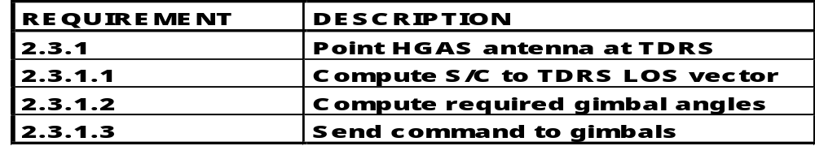
Requirements Analysis
FUNCTIONAL ANALYSIS
  Also called functional decomposition
  The process of allocating or decomposing functions to lower system levels
  Defines system functional architecture
  An example:

Slide 30
Requirements Analysis
"When your only tool is a hammer,
every problem looks like a nail."
Bruce Pittman & Others

Slide 31
Requirements Analysis
N2 chart example
Instrument Data
Spacecraft
Data
Capture
Data
Archive
Operations
Console
Science
Console
Science Results

Slide 32
Requirements Analysis
Data Flow Diagram Example
Command
Capture
Valid Cmds
TL Cmds
Command Timeline
Executive
Commands
Cmd Status
TL Status
Command
Executive
CC TM
TL Cmds
Cmd Status
RT Cmds
CE TM
Telemetry
Output
CE TM
CTE TM
Other
Elements
Other TM

Slide 33
Requirements Analysis
Control Flow Diagram Example
Interrupts
ISR
Interrupt Requests
Real Time Executive
Resume
Suspend
Status
Resume
Suspend
Status
Resume
Suspend
Status
Task A
Task B
Task N

Slide 34
Requirements Analysis
Flowchart Example
Input Requirements
Mission Objectives
Mission Environments
Mission Constraints
Measures of Effectiveness
Functional
Analysis
Synthesis
Acceptable
Solution
Evaluation
and Decision
(Trade-off)
OR
OR
Will
Alternatives
Work?
Technology Selection Factors
Hardware
Software
Reliability
Maintainability
Personnel/Human Factors
Survivability
Security
Safety
Standardization
Integrated Logistics Support
EMC
System Mass Properties
Produceability
Transportability
Electronic Warfare
Computer Resources
Description of
System Elements

Slide 35
Requirements Analysis
Understand User
Requirements, Develop
System Concept and
Validation Plan
Demonstrate and
Validate System to
User Validation Plan
Develop System
Performance Specification
and System
Verification Plan
Integrate System and
Perform System
Verification to
Performance Specification
Expand Performance
Specifications Into CI
“Design-to” Specifications
and Inspection Plan
Assemble CIs and Perform
CI Verification to CI
“Design-to”
Specifications
Evolve “Design-to”
Specifications into
“Build-to” Documentation
and Inspection Plan
Inspect to
“Build-to”
Documentation
Integration and
Verification Sequence
Decomposition &
Definition Sequence
Fabricate, Assemble, and
Code to “Build-to”
Documentation

Slide 36
Requirements Analysis
DESIGN MARGINS
  An integral part of the requirements analysis and design synthesis process
  Proper margins minimize risk
  Reduce the impact of requirements changes
  Allow the balancing of allocations between subsystems and subsystem elements
  Margin levels (percentages) may be reduced as the design matures
  Robustness is the capability of a design to meet functional and performance requirements as the environment or design parameters change
  Flexibility is the ability of the design to adapt to failures, modeling inadequacies, changes in requirements , or operational changes

Slide 37
Requirements Analysis
SOME GENERAL GUIDELINES
  Look one level up in the hierarchy to clearly understand the objectives, constraints, and environment of your system
  Use creative thinking processes
    First diverge then converge
    Turn off the critic as you diverge
  Work top-down - a level at a time - work for breadth rather than depth at each iteration
  Do not ignore standard assemblies, components, subsystems, etc. - Do not force fit either
  Take a step back occasionally to consider how the system "feels" - can you envision it meeting its objectives, or is the feeling discordant?

Slide 38
Requirements Analysis
THE REQUIREMENTS GOSPEL ACCORDING TO JOHN - Version 4
  A SYSTEM is defined by a set of OBJECTIVES, its environment, its useful life, and its constraints
  A system cannot be VALIDATED until the objectives are defined by a set of measurable SYSTEM (FUNCTIONAL AND PERFORMANCE) REQUIREMENTS
  System requirements are ALLOCATED and DECOMPOSED to define lower level requirements
  Confirm the TRACEABILITY of lower level requirements to system requirements

Slide 39
Requirements Analysis
  THE REQUIREMENTS GOSPEL ACCORDING TO JOHN - Version 4 (cont’d)
  A system is VERIFIED when it is shown to meet all requirements
  A system is VALIDATED when its requirements are shown to satisfy all objectives and its design is shown to satisfy all requirements
  If lower level requirements are not traceable (ORPHAN requirements), then the system being built is not JUSTIFIED
  If system requirements are not allocated (UNALLOCATED requirements), then the system being built is not VALID

Slide 41
Background Charts
RAVISH
Example: The XTE Requirements Database
Current Practice

Slide 42
Requirements Analysis
Requirements
Analysis for
Verification
In a
Structured
Hierarchy

Slide 43
Requirements Analysis
RAVISH: Motivation
  Design is a top-down process:
  Functional allocation flows from mission to system to subsystem to assembly, to component
  Verification is a bottom up process:
  Verification flows from component to assembly to subsystem to system
  At integration verification becomes system level
  Most work breakdown structures assign subsystem responsibility to a single subsystem lead (or manager)
  The result is that it is most efficient to develop a requirements hierarchy which reflects the WBS hierarchy

Slide 44
Requirements Analysis
RAVISH: Requirements Analysis methodology consists of:
  A strict top-down allocation of requirements
  Allocation flow is from system to subsystem, to mission phase, to functional category, to function, to performance specification
  Functional requirements are specified without performance numbers using a single simple sentence for each
  Performance requirements which quantify each functional requirement are attached to the functional requirement
  [A requirements validation walkthrough is conducted]

Slide 45
Requirements Analysis
  The verification method for each functional and performance requirement is specified
  [A requirements verification methods walkthrough is conducted]
  The verification procedure for each functional and performance requirement is specified
  [A verification specification walkthrough is conducted]

Slide 46
Requirements Analysis
THE XTE REQUIREMENTS DATA BASE
Spacecraft Requirements Organized Hierarchically by:
  Subsystem
  Mission Operational Phase
  Functional Category
  Function
  Performance Required

Slide 47
Requirements Analysis
THE XTE REQUIREMENTS DATA BASE
An Example:
  First Level: System: 01: XTE Spacecraft
  Second Level: Subsystem: 08: Mechanical
  Third Level: Mission Phase: 00: General
  Forth level: Functional Category: 01: Design
  Fifth Level: Function: 01: Strength
  Sixth level: Performance: 01: Limit Loads Safety Factor
“An ultimate factor of safety of 1.4 on limit loads shall
be used for design requirements.”

Slide 48
Requirements Analysis
RATIONALE FOR RAVISH METHODOLOGY
  By making each functional requirement separate from its associated performance requirements, functional validation of the requirements is simplified. (Associatively)
  By associating performance requirements with each functional requirement, the items which are needed to verify the functional requirement are clearly identified as a group. (Modularity)
  By grouping requirements by subsystem, each subsystem lead has a definitive set of system level requirements which drives the design. (Clarity)
    The fundamental functional and performance requirements for the subsystem are known
    This provides each subsystem with a validation basis

Slide 49
Requirements Analysis
  By specifying requirements for each mission phase, design consideration is given to each phase equally. This avoids "band-aid" approaches to providing the functionality required. (Uniformity)
  By specifying the verification methods, procedures for each requirement, early identification of special verification tasks, equipment, and facilities is provided. (Verifiability)
  By conducting walkthroughs for requirements validation, verification methods, and verification procedures, the quality (correctness and completeness) of the process is ensured.

Slide 50
Requirements Analysis
REQUIREMENTS VALIDATION WALKTHROUGH
  Identify and correct
    Unallocated system requirements
    Orphan requirements
  Validate
    From the bottom up ensure that all top level requirements (objectives, constraints, environment, and lifetime) are being met
  Establish margins
  Identify trades , risks, and issues
    Identify and prioritize trade studies
    Identify risk mitigation efforts - prototyping, special testing, etc.

Slide 51
Current Practice
Requirements Analysis
The Operational Phase level has been eliminated. It proved to be cumbersome.
For early iterations only 3 levels are often needed
Commercial tools like DOORS and SLATE are increasingly being used at NASA

Slide 52
Requirements Analysis
SUGGESTED READING:
  Center for Systems Management, “PPMI SYSTEMS ENGINEERING”, Course materials
  Pittman & Associates, “DYNAMIC SYSTEM ENGINEERING”, Course materials
  Shisko & Chamberlain, NASA SYSTEMS ENGINEERING HANDBOOK, Draft, September 1992
  Wertz & Larson, SPACE MISSION ANALYSIS AND DESIGN
  Azzolini, John, Essential Systems Engineering: A Life-cycle Process, 5th Annual Symposium of NCOSE, 1995
  Martin, James N., Overview of the EIA 632 Standard - “Processes for Engineering a System”
  NPG 7120.5A <<http://nodis.hq.nasa.gov/Library/ Directives/ NASA-IDE/Procedures/ Program_Formulation/ N_PG_7120_5A.html>>

